Slide 1


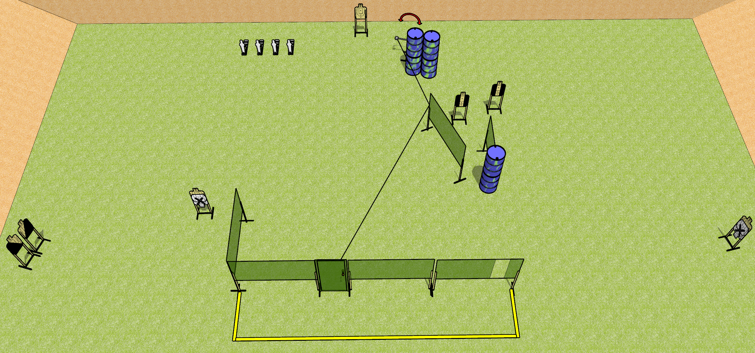
 | Dothan Gun Club – USPSA Match Pain is the Only Way Out Course Designer : Drew Coleman
Round Count 20 rounds 8 USPSA 4 MP
Equipment List 10 wall feet 1 swinger + door + activator 1 left + 1 right diag, 2 tux, 4 targets (3 scoring + 1 NS)

Slide 2
Pain is the Only Way Out
Written Stage Briefing
Pain is the Only Way Out is a 20 round, 100 point, Comstock course of fire. There are 8 USPSA targets and 4 steel. The best 2 hits on cardboard will score and steel must fall to score.
The swinger is activated by opening the door and remains visible at rest.
Handgun start position is both hands touching door handle. Handgun is loaded and holstered.
PCC start position is muzzle touching doorknob, stock on belt. Loaded carbine is held with both hands, safety on.
On the audible start signal, engage targets as they become available from within the shooting area.

